Slide 1

Taxonomic RuleML Tab
Onut Iosif-Viorel
Sandeep Singh

Slide 2

Contents
Introduction
TXRuleML Tab
Modules
Installing and Running TXRuleMLTab
Limitations and Future Work

Slide 3
Introduction
TXRuleML
Protégé
  Protégé API
  Extending Protégé

Slide 4
Taxonomic RuleML
Rules representing subsumption (sub-type) links
Mammal
<sub>
<_shead><rel>Mammal</rel></_shead>
<_sbody>
<sor>
<rel>Cat</rel>
<rel>Dog</rel>
</sor>
</_sbody>
</sub>
Cat
Dog

Slide 5
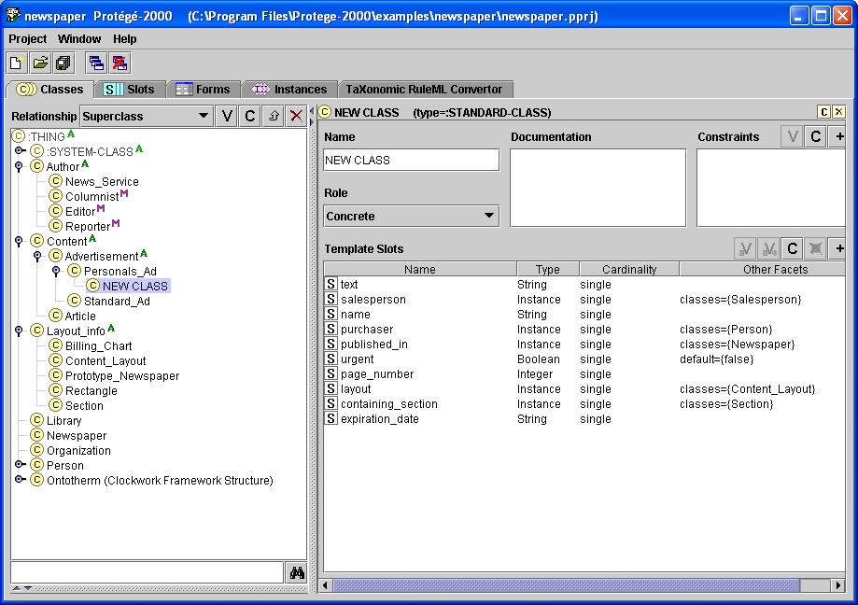
The Protégé API
Protégé is-
a tool which allows the user to:
  construct a domain ontology
    Create Classes, Instances, Attributes & Slots
View Class
Create Class
Delete Class
View Attribute
Create Attribute
Delete Attribute

Slide 6
The Protégé API
Protégé is-
a tool which allows the user to:
  construct a domain ontology
    Create Classes, Instances, Attributes & Slots
  customize data entry forms
    Customize Slot-Widgets & TAB-Widgets

Slide 7
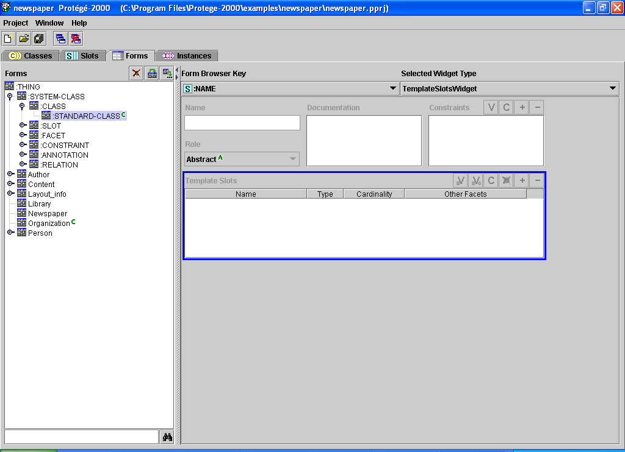
The Protégé API
Protégé is-
a tool which allows the user to:
  construct a domain ontology
    Create Classes, Instances, Attributes & Slots
  customize data entry forms
    Customize TAB-Widgets & Slot-Widgets

Slide 8
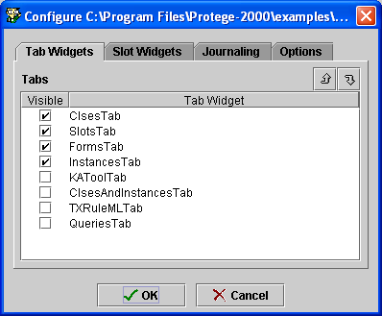
The Protégé API
Protégé is-
a tool which allows the user to:
  construct a domain ontology
    Create Classes, Instances, Attributes & Slots
  customize data entry forms
    Customize Slot-Widgets & TAB-Widgets

Slide 9
The Protégé API
Protégé is-
a tool which allows the user to:
  construct a domain ontology
    Create Classes, Instances, Attributes & Slots
  customize data entry forms
    Customize TAB-Widgets & Slot-Widgets
  enter data
    GUI & API
a platform which can be extended
→ Extendible GUI
a library for other applications

Slide 10
Contents
Introduction
TXRuleML Tab
Modules
Installing and Running TXRuleMLTab
Limitations and Future Work

Slide 11
TXRuleML Tab
What it is
  Taxonomic RuleML Tab – A Plug-in to Protégé
What it does
  TXRuleML to Taxonomic Hierarchy
  Taxonomic Hierarchy to TXRuleML
  Validating TXRuleML

Slide 12
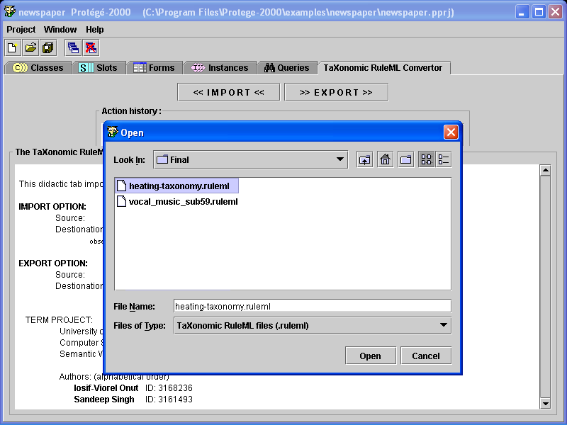
Importing

Slide 13
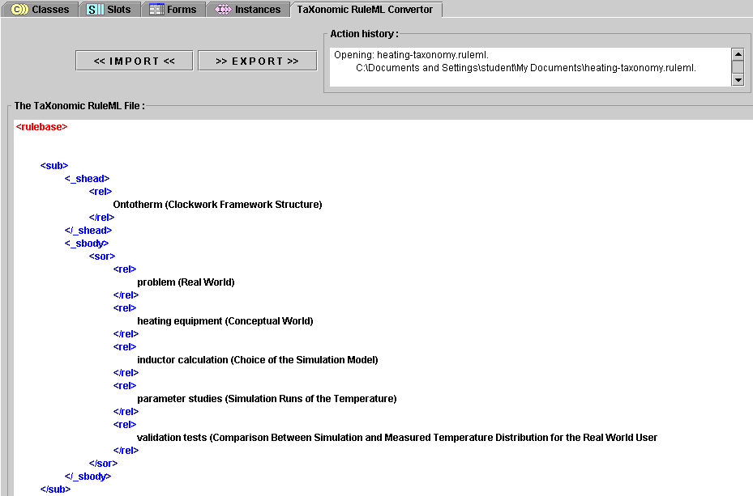
Importing

Slide 14
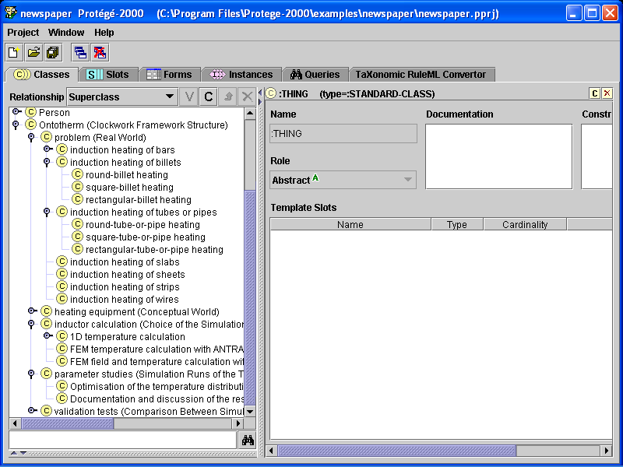
Importing

Slide 15
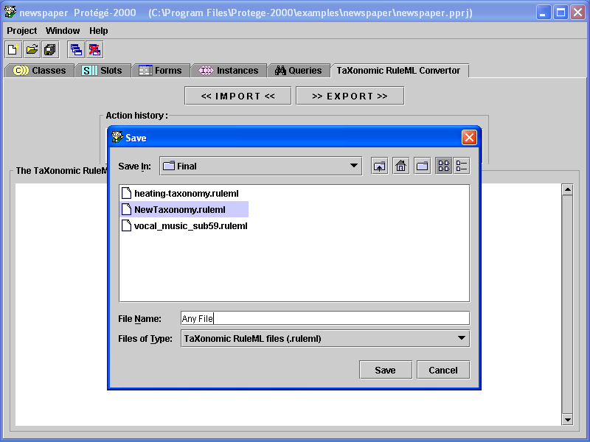
Exporting

Slide 16
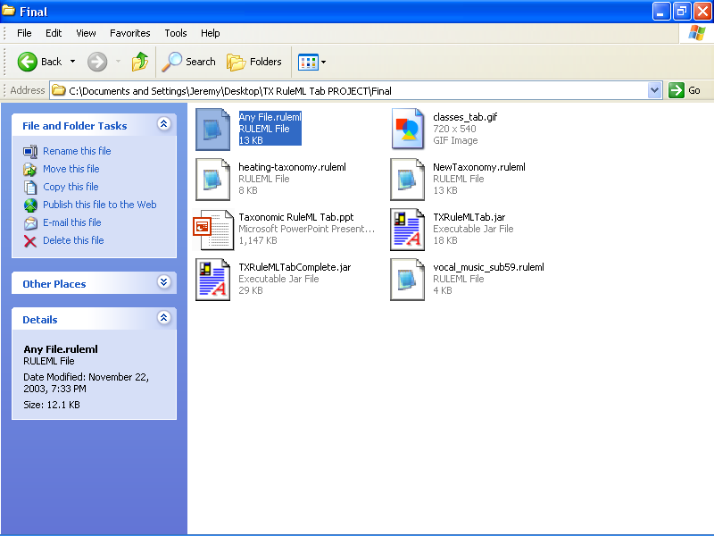
Exporting

Slide 17
Validating
Not well formed ruleML files are rejected
Files are checked for
  Order of tags
  Completeness of tags
  Invalid text

Slide 18
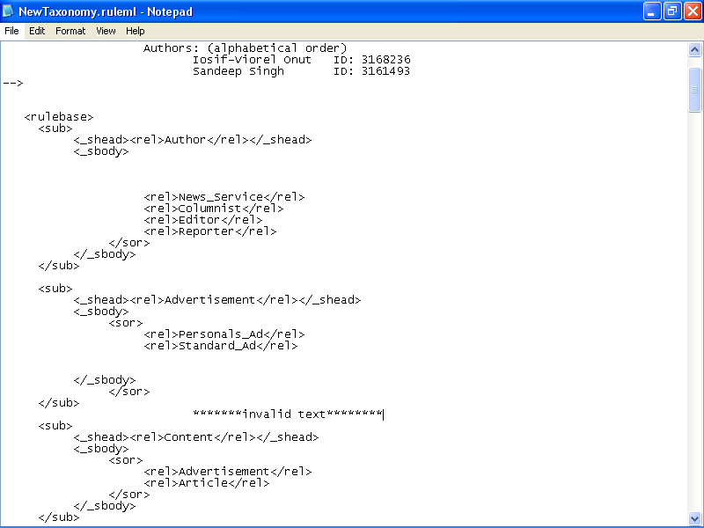
Validating
Missing Tag
Incorrect Order
Invalid Text

Slide 19
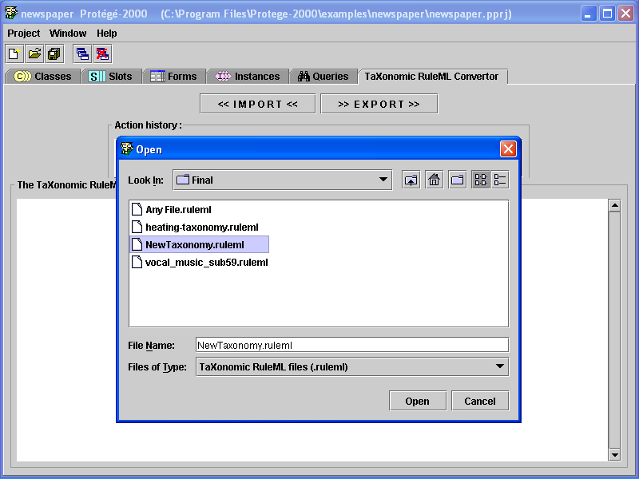
Validating

Slide 20
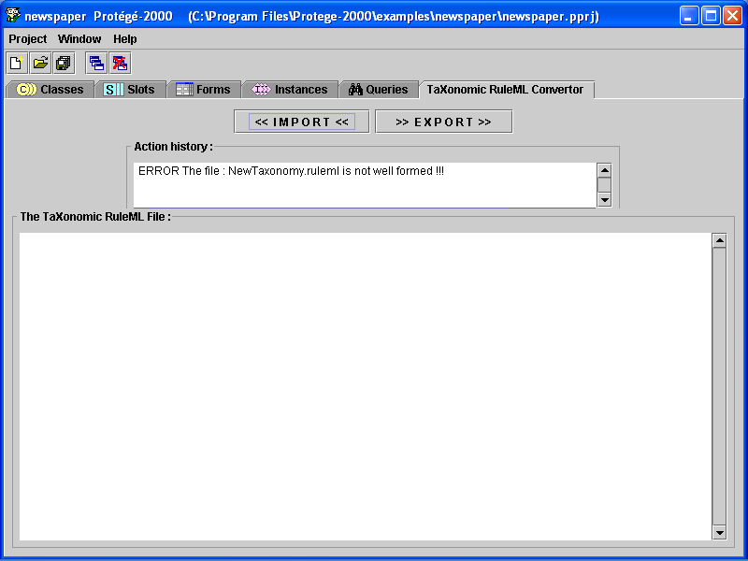
Validating

Slide 21
Contents
Introduction
TXRuleML Tab
Modules
Installing and Running TXRuleMLTab
Limitations and Future Work

Slide 22
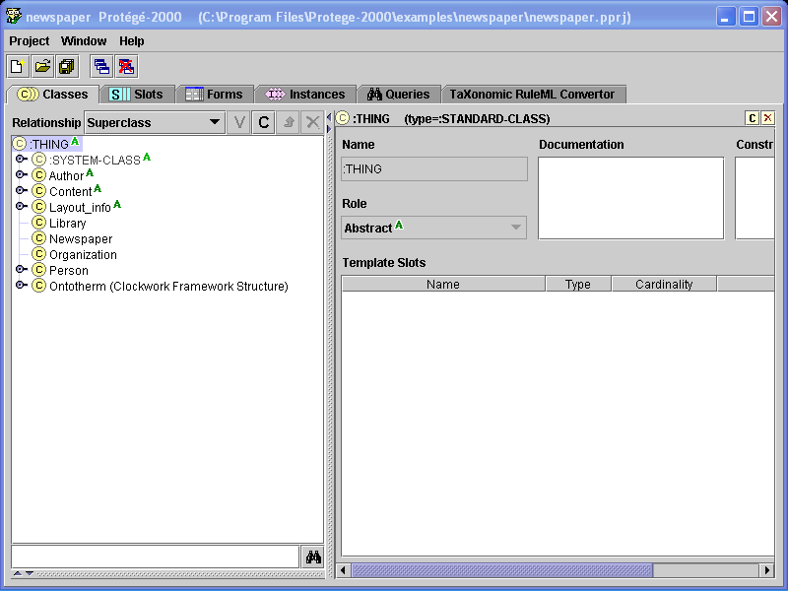
Modules
OntologyConnection Class
API
OntologyConnection
Create Class
Get Class

Slide 23
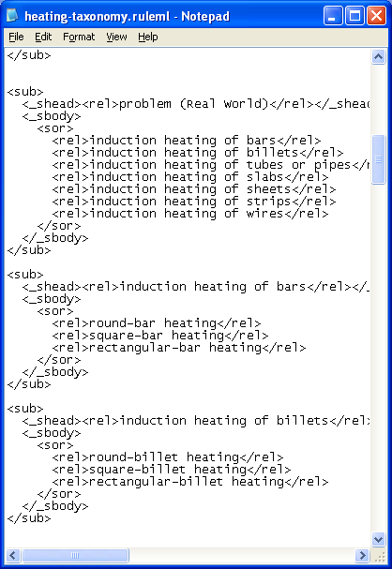
Modules
OntologyConnection Class
TXRuleMLConnection Class
TXRuleMLConnection
Process the file

Slide 24
Modules
OntologyConnection Class
TXRuleMLConnection Class
TXRuleMLTab Class
TXRuleMLTab
Initialize Tab Design
TXRuleMLConnection
Process the file
OntologyConnection
Create Class
Get Class

Slide 25
Modules
OntologyConnection Class
TXRuleMLConnection Class
TXRuleMLTab Class
Parser Class
Parser
Validation
TXRuleMLConnection
Process the file

Slide 26
Contents
Introduction
TXRuleML Tab
Modules
Installing and Running TXRuleMLTab
Limitations and Future Work

Slide 27
Installing and Running TXRuleMLTab
Installing Protégé
Copying the Jar File
Choosing the Plug-in

Slide 28
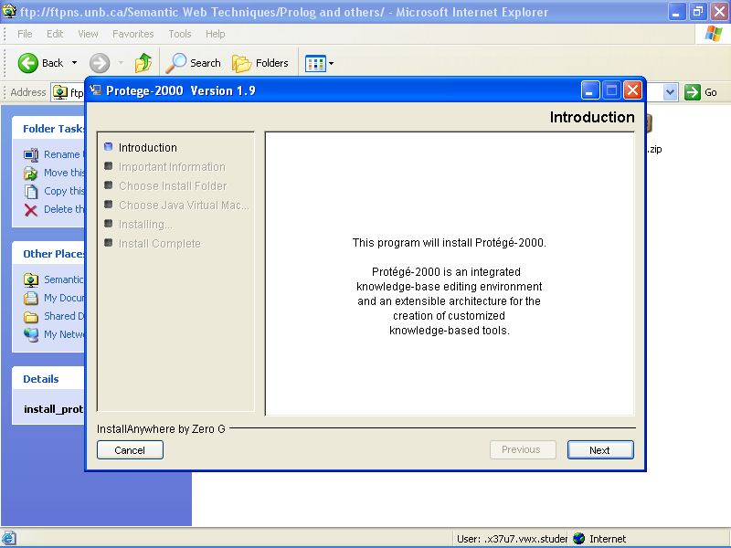
Installing Protégé
http://protege.stanford.edu/

Slide 29
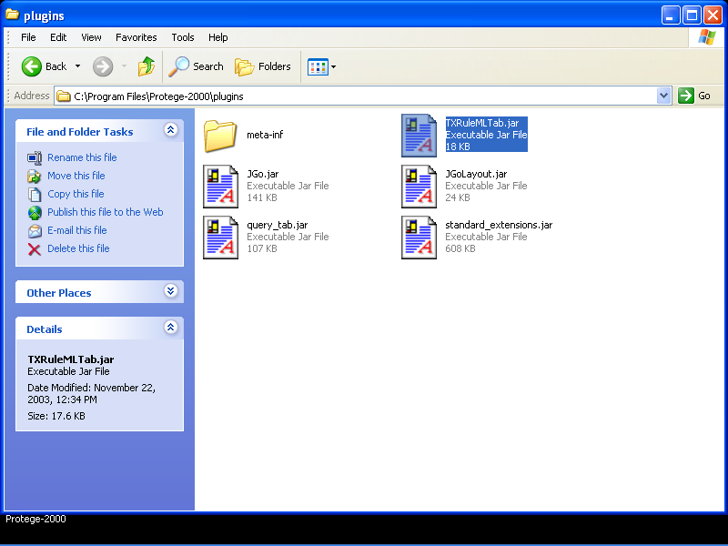
Copying the Jar File

Slide 30
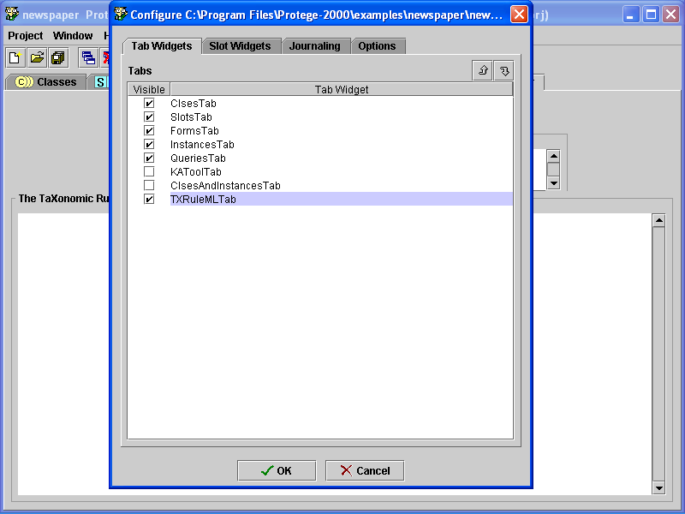
Choosing the Plug-in

Slide 31
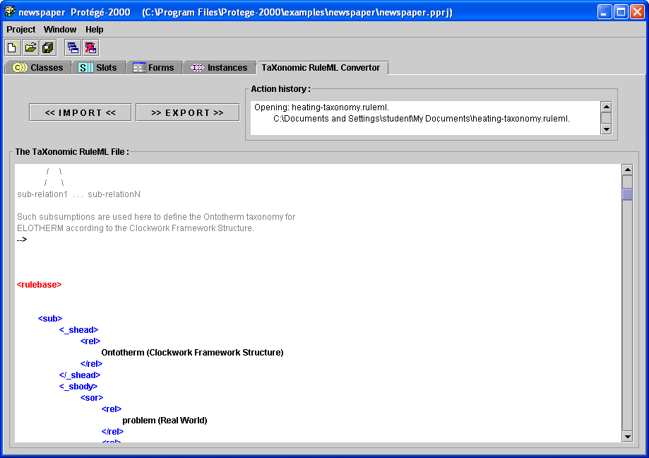
The Result

Slide 32
Contents
Introduction
TXRuleML Tab
Modules
Installing and Running TXRuleMLTab
Limitations and Future Work

Slide 33
Limitations and Future Work
Support for Multiple Inheritance
TXRuleML Editor
Auto correcting the TXRuleML File

Slide 34
Support for Multiple Inheritance
TXRuleML Tab does not support relations like
Carnivore
Mammal
Cat
<sub>
<_shead>
<sand>
<rel>Carnivore</rel>
<rel>Mammal</rel>
</sand>
</_shead>
<_sbody>
<rel>Cat</rel>
</_sbody>
</sub>

Slide 35
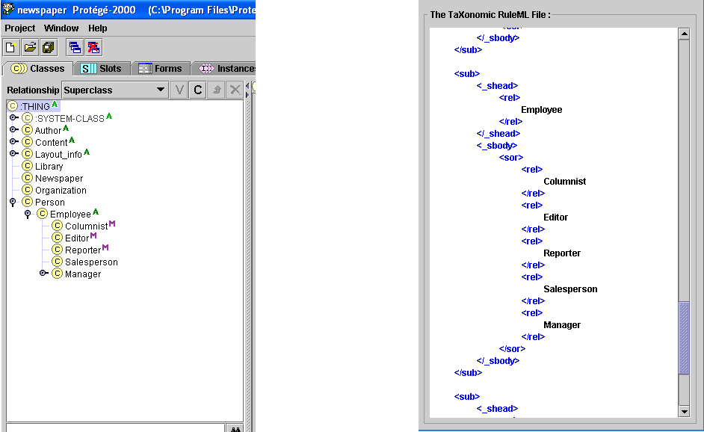
RuleML Editor
Ability to compose the TXRuleML file in the Protégé window itself

Slide 36
Auto-correcting TXRuleML Files
Suggesting appropriate changes to be made
Making corrections which are too obvious

Slide 37
Questions?

Slide 38
Taxonomic RuleML Tab
Onut Iosif-Viorel
Sandeep Singh

